Slide 1


Slide 2
Moto and Agenda {5 starts}
Promoting cause of education for unprivileged child and youth.
Awareness and supporting games and sports.
Educate a women, empower a woman!.
Working on pollution reduction, awareness of cleanliness for healthy life.
Faith and funding to individual or family with special needs.

Slide 3
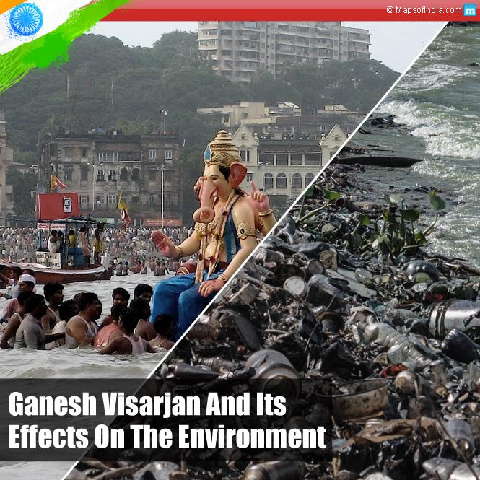
ENVIRONMENTAL AWARENESS
Environmental issues are any such issues created due to human activities and causes harm to the environment.

Slide 4
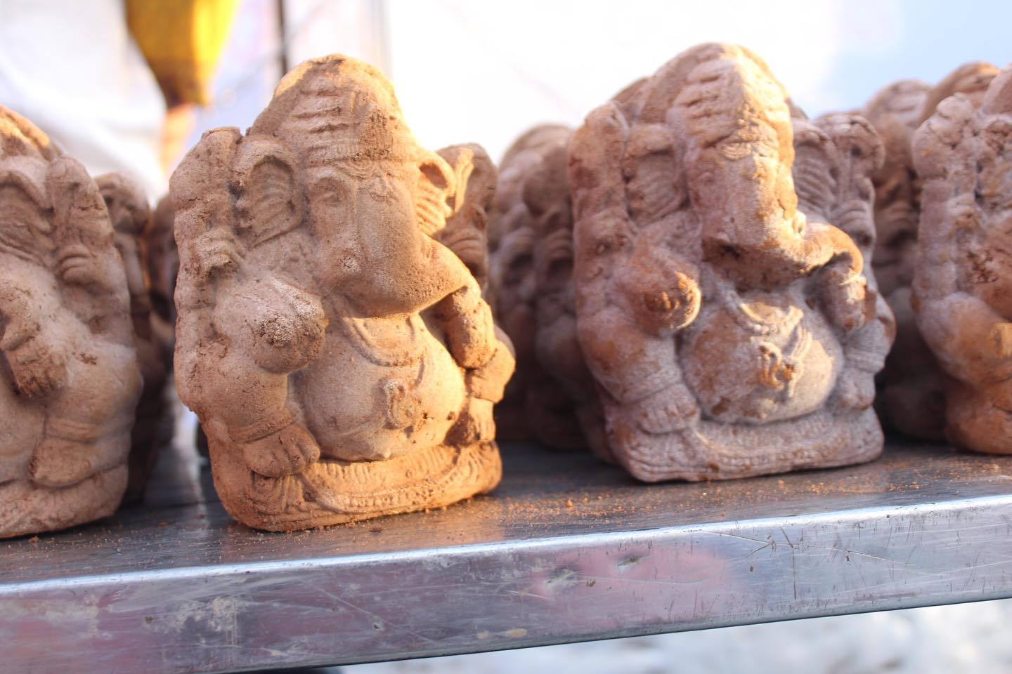
AIM
Little Hands Organization distributed 5000 clay Ganesha idols for free for the fifth consecutive year at the clock tower center in Narasaraopet this year.
Received a special response from the people and devotees of the town.

Slide 5
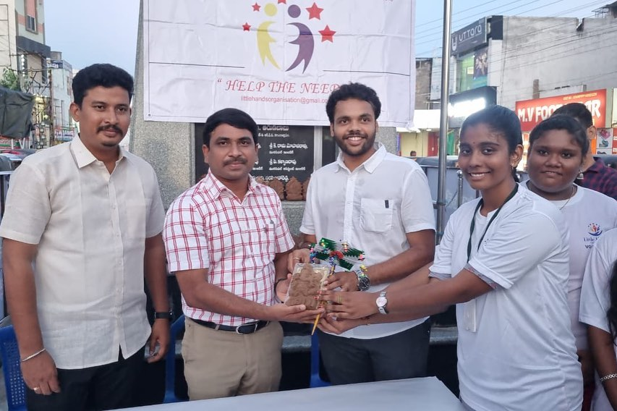
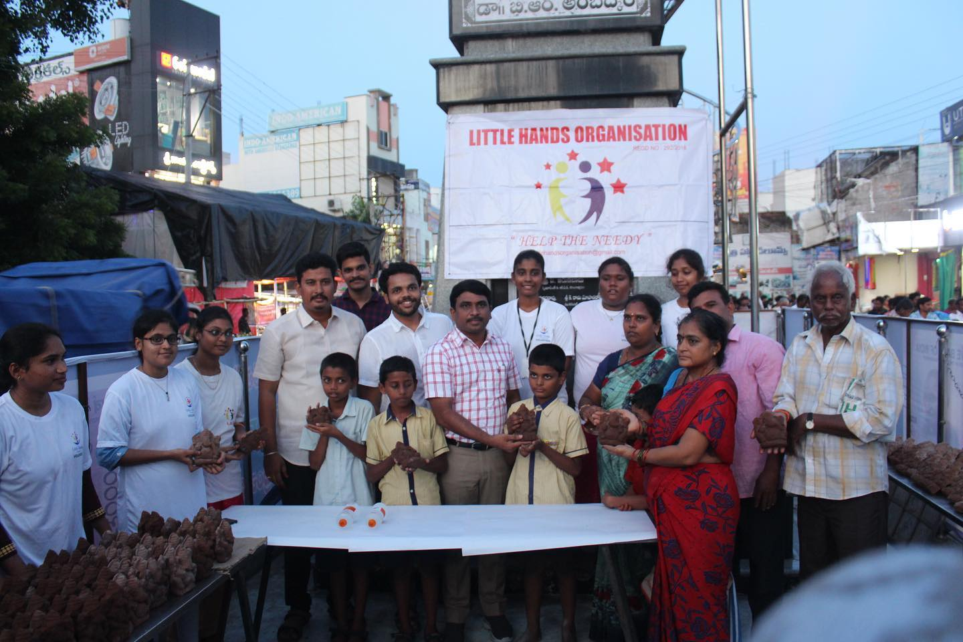
District collector Siva sankar L had inaugurated event and encouraged citizens to prefer eco friendly ganesh. Later district collector had extended his support to Team LHO.

Slide 6
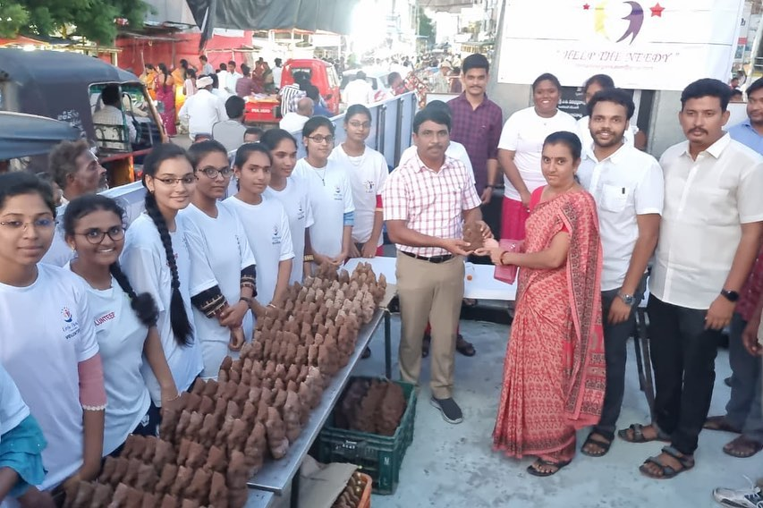
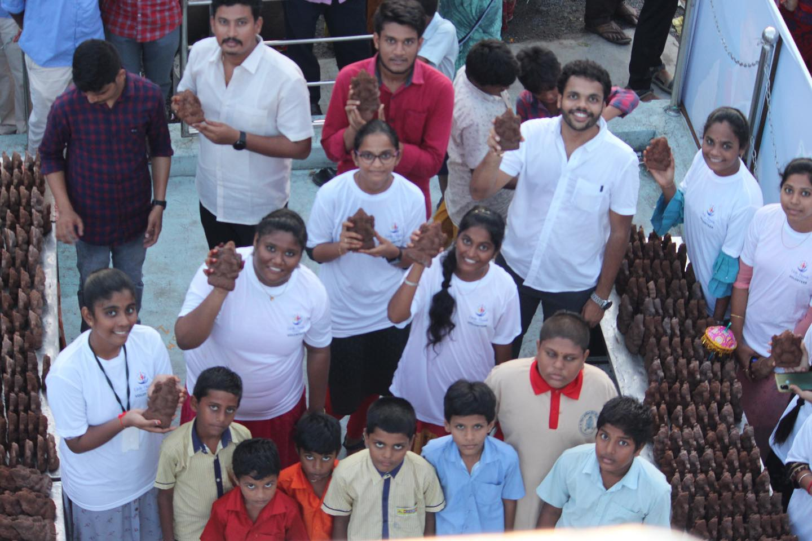
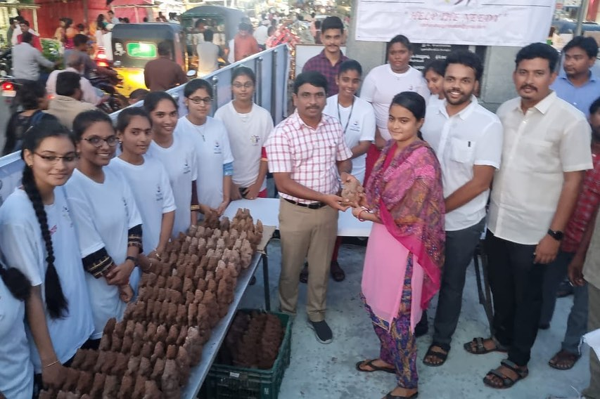

Slide 7
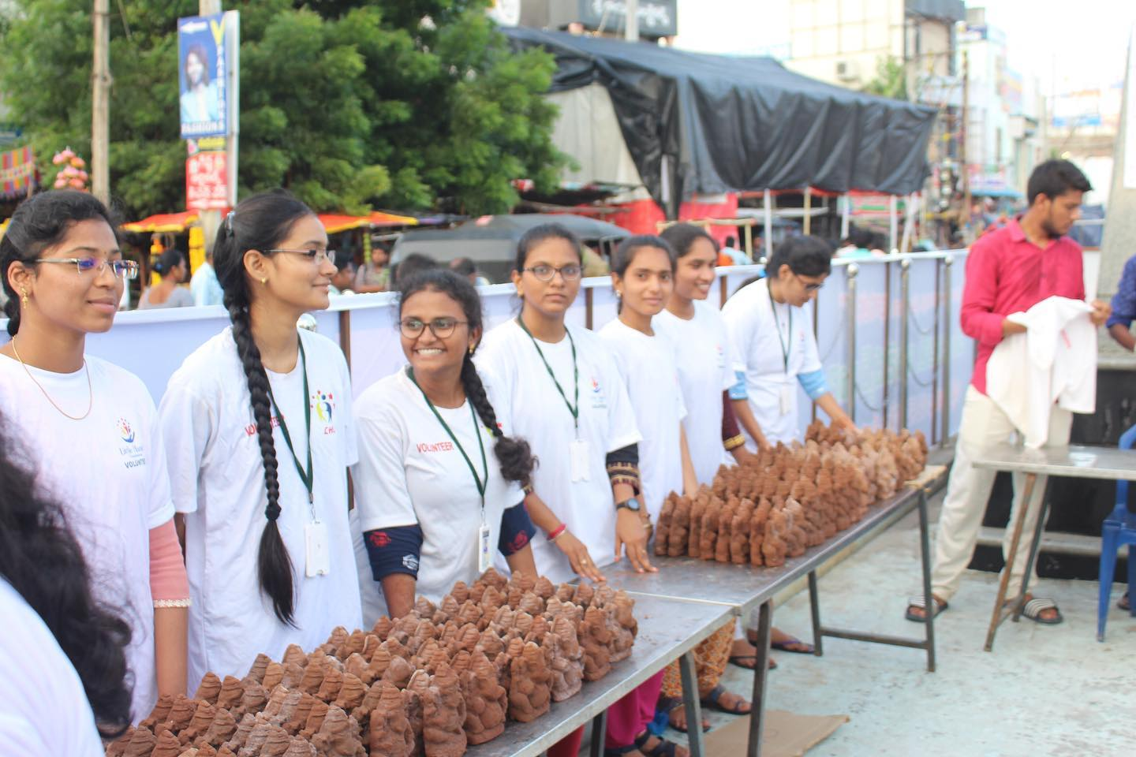
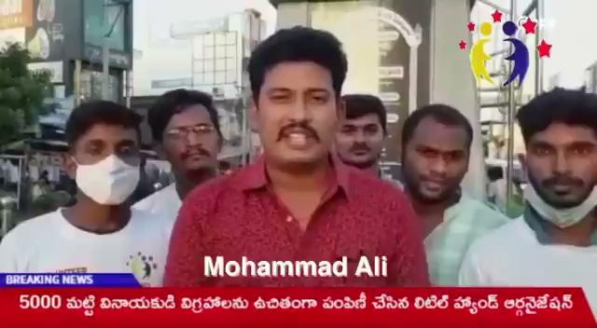

Slide 8
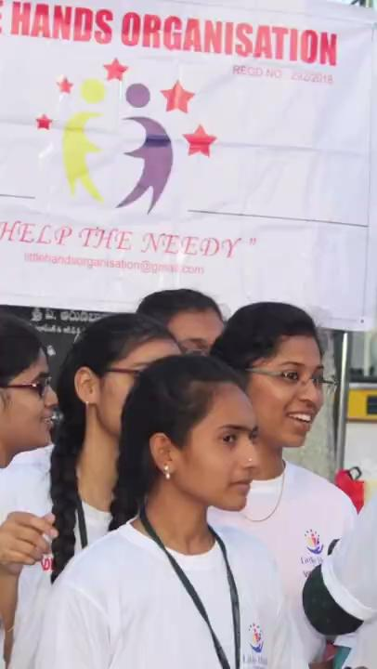

Slide 9
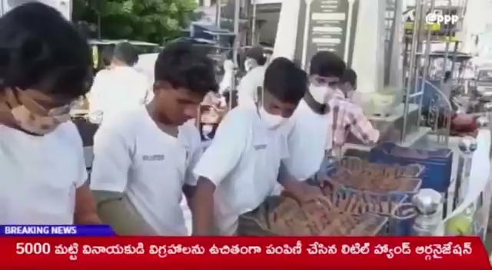

Slide 10
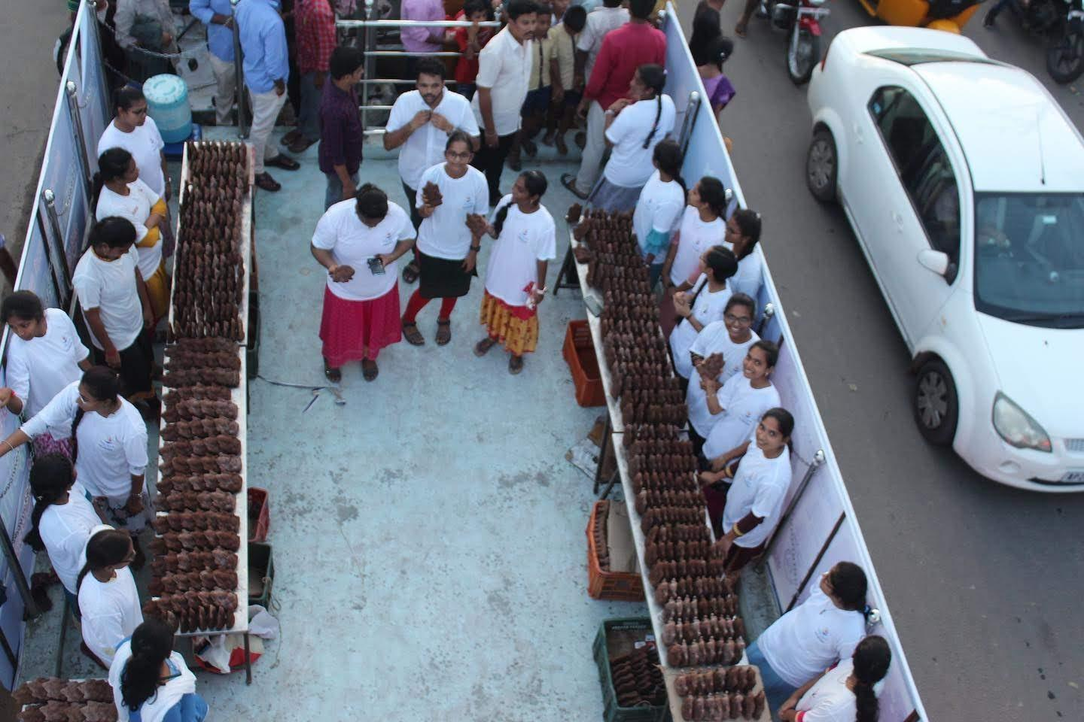

Slide 11
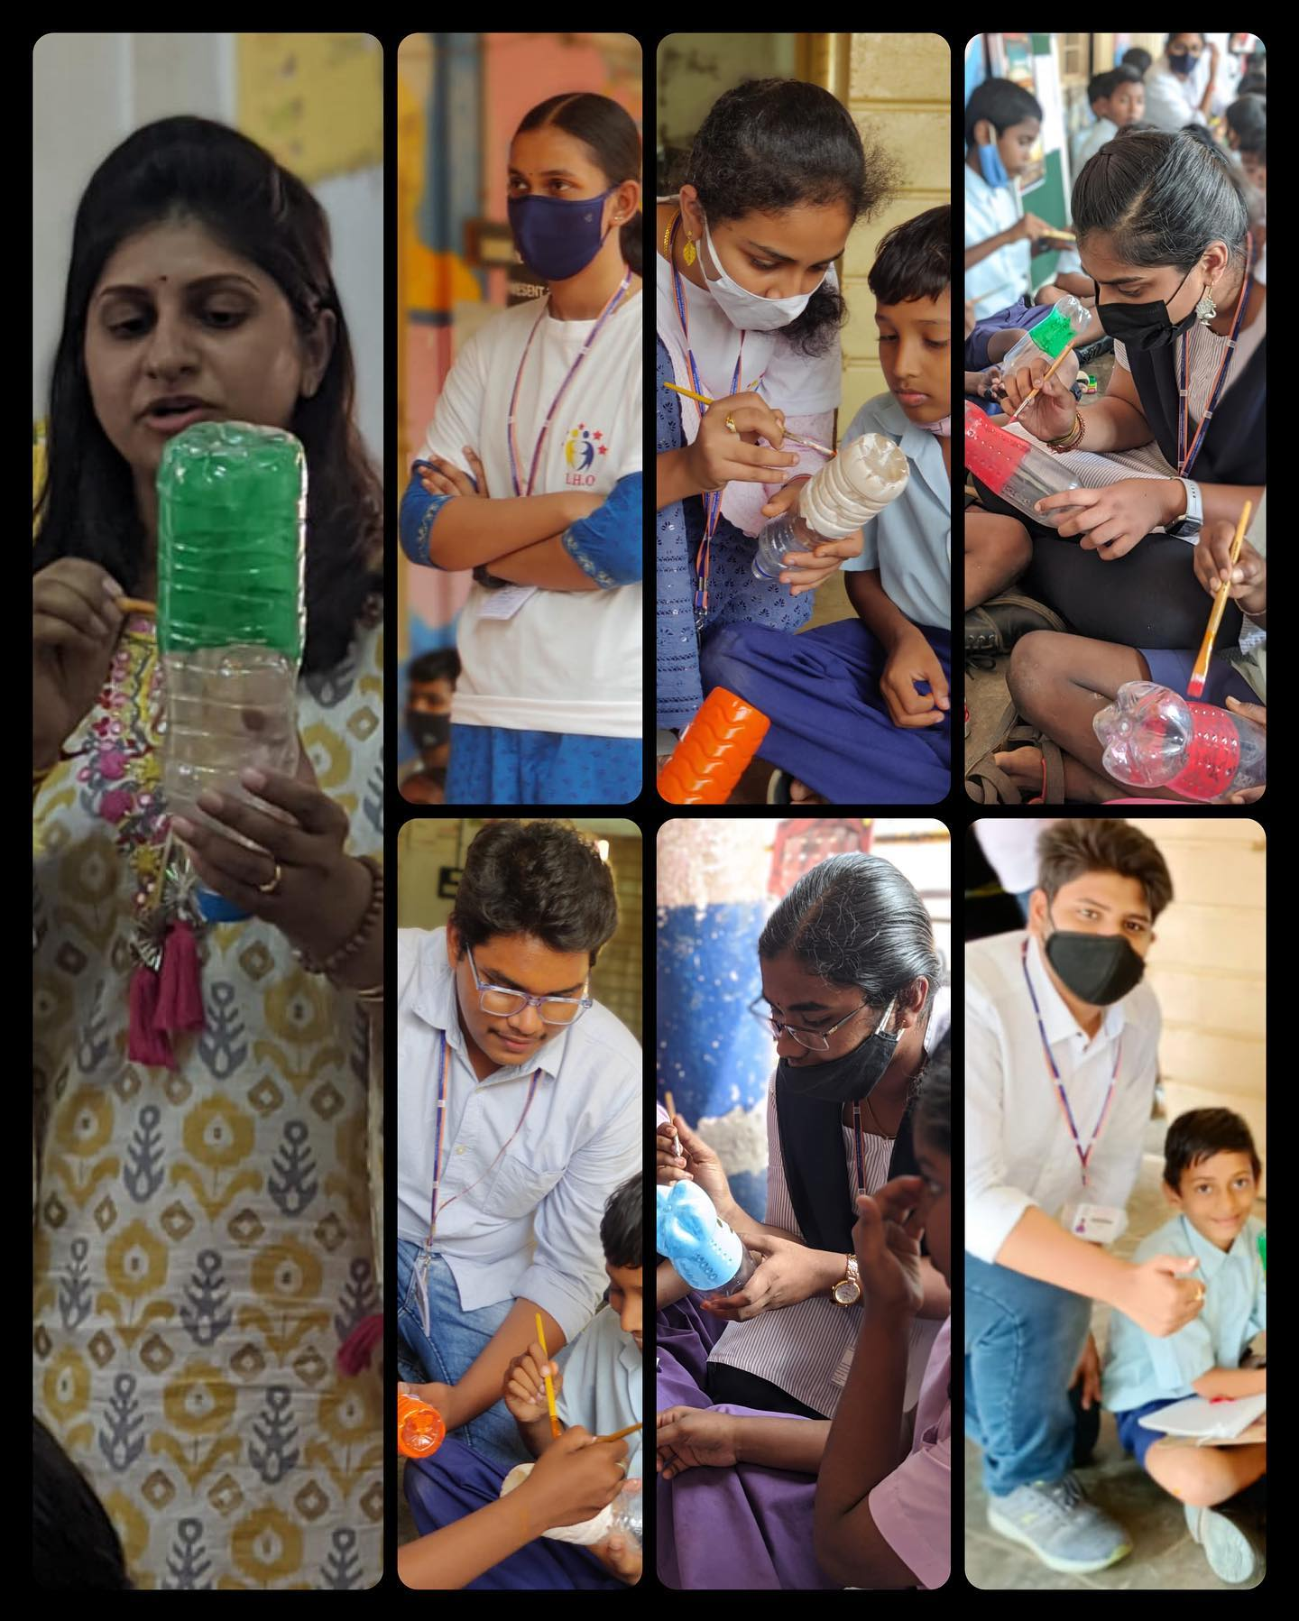
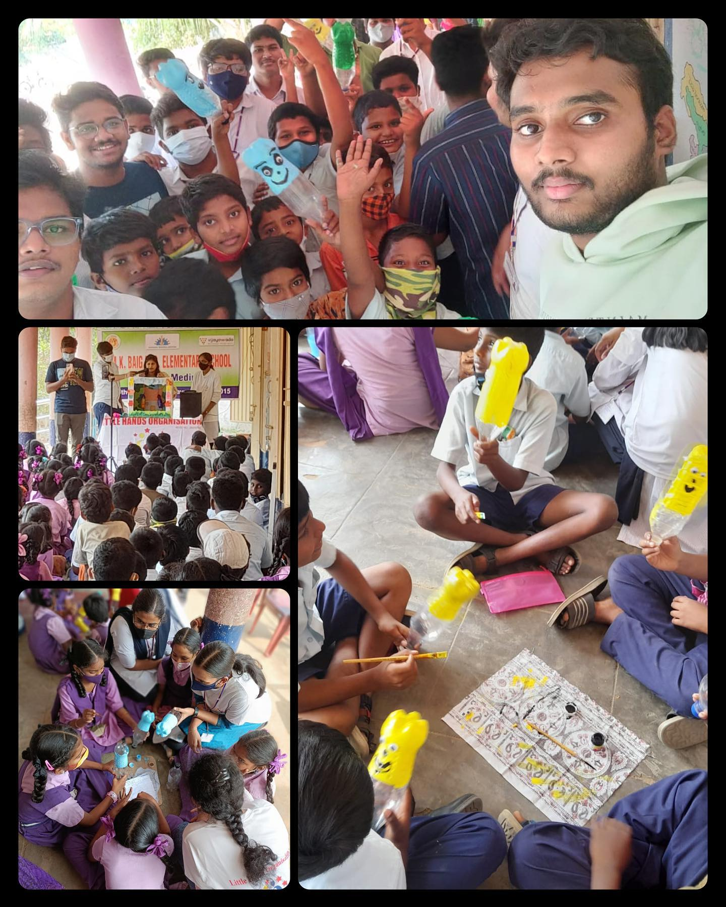
We also educated children of schools to create responsibility to the environment
We also make children to be more creative and creative skills on waste out of best
We make outdoor activities regarding the environmental pollution and awareness programmes

Slide 12
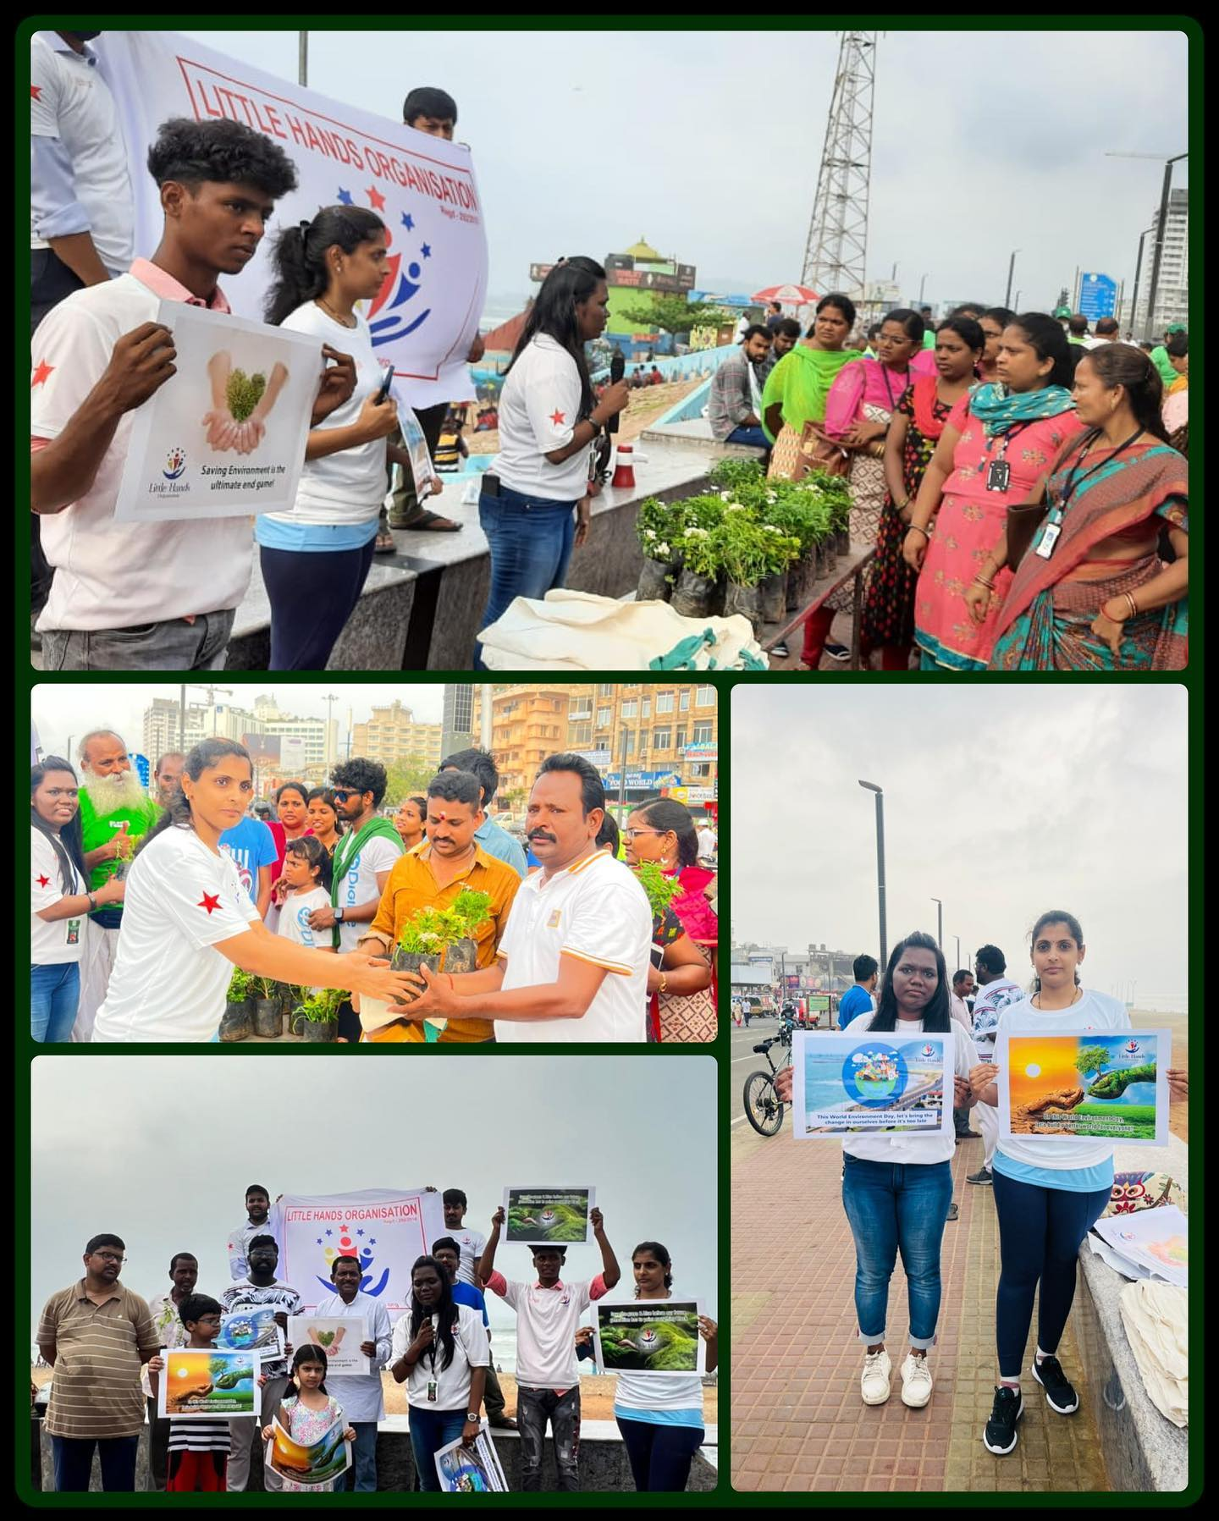
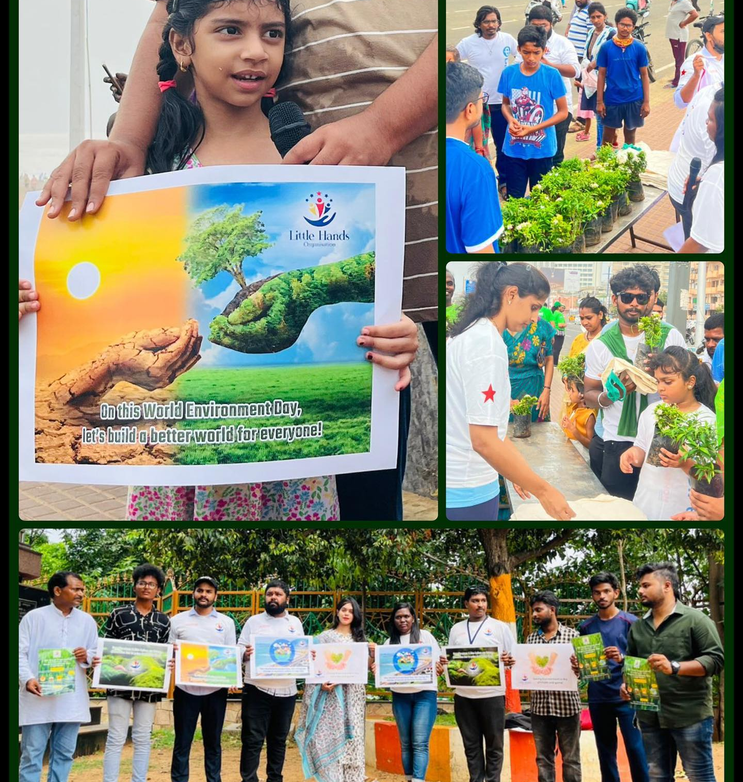

Slide 13
